Slide 1
Flu Season
© 2017 Lanternfish ESL at www.bogglesworldesl.com

Slide 2
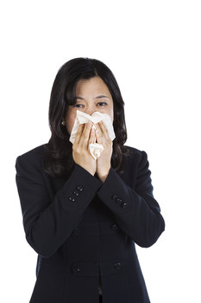
The Flu
The flu is a highly contagious disease. The flu is a respiratory illness caused by a virus that infects the nose, throat, and lungs. Usually the flu is a minor illness, but for some people it can be very serious.

Slide 3
Vocab:
A contagious disease is a disease that spreads from person to person.
A respiratory illness is a disease that affects the lungs.
If you infect a person with a disease that means you give the disease to the person. If a person is infected that means the person has the disease.

Slide 4
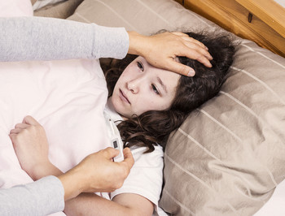
Flu Symptoms
Do you have a fever? A fever is one of the main symptoms of the flu. Do you also have a cough, a sore throat, a headache, a body ache, vomiting, or diarrhea? These are other symptoms of the flu. If you have some of these symptoms you may have the flu.

Slide 5
Vocab:
If you have a fever that means your body temperature is high. Some people define fever as a temperature greater than 37.5 degrees.
A symptom is a sign of a disease. Symptoms include things such as a cough, a sore throat, and a fever.
Vomiting is another way to say, “throwing up.”

Slide 6
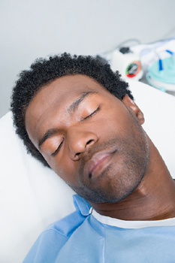
Flu Treatment
What should you do if you have the flu? For most people, the best thing to do is to stay home and rest. You should also drink plenty of fluids. There is no need to go to emergency and no need to take anti-viral drugs.

Slide 7
Vocab:
A treatment is a method to cure a disease.
Emergency is the place in a hospital where very seriously ill or injured people go.
Anti-viral drugs are medicines that help fight viruses such as the flu.

Slide 8
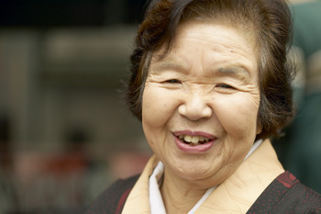
Flu Treatment for At-risk Groups.
However, for some groups of people, the flu can be very dangerous. For these at-risk groups, the flu can cause serious complications such as pneumonia. These groups include the elderly, young children, and people with medical conditions. People in these groups may need medical attention if they have the flu.

Slide 9
Vocab:
At-risk groups are groups of people that have a higher chance of becoming seriously ill.
A complication of a disease is a more serious condition caused by a disease.
Medical conditions are medical problems such as cancer, asthma, high blood pressure, and HIV.

Slide 10
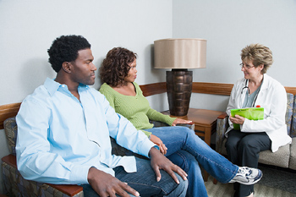
Signs that Children Need Medical Attention
For children, there are some important signs that they may need emergency treatment. These signs include having a bluish skin color, having a fever with a rash, having difficulty breathing, not drinking enough fluids, not waking up and not interacting with people.

Slide 11
Vocab:
If you need medical attention that means you should see a doctor.
A rash is an area of skin with red spots or red bumps.
If you interact with someone that means you talk to that person or react to what they do.

Slide 12
Signs that Infants Need Medical Attention
For infants, some important signs that they need emergency treatment include not eating, trouble breathing, and no tears when crying.

Slide 13
Vocab:
Infant is another word for baby.

Slide 14
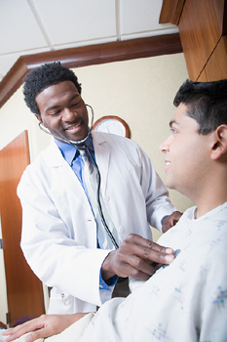
Preventing the Flu
There are several things you can do to prevent the flu. One way to prevent the flu is to wash your hands often. You should wash your hands before meals, when you come home, when you go to the bathroom, and when you have been around sick people. Most people do not wash their hands long enough when they wash their hands. You should use soap and scrub thoroughly.

Slide 15
Vocab:
If you prevent something that means you stop it from happening.
Scrub is another way to say, “Wash hard.” You scrub pots and pans when food is stuck to them.

Slide 16
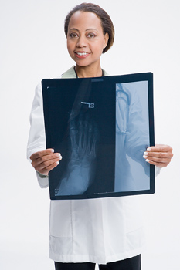
The Flu Vaccination
Another way to prevent the flu is to get your flu vaccination. The flu shot is cheap and effective for preventing the flu.

Slide 17
Vocab:
A vaccination is a type of medicine that can prevent a disease.
If something is effective that means it works well.

Slide 18
Preventing the Spread of the Flu
If you do have the flu, it’s also important to prevent spreading it to other people. You should stay home and avoid contact with other people. You should avoid going out into crowds. You should also cover your mouth and nose when you cough or sneeze.

Slide 19
Vocab:
If you avoid something that means you try to stay away from it.
A crowd is a large group of people gathered together.
If you cover your mouth that means you block your mouth with your hand or arm so that germs can’t spread.

